Slide 1
Safeguarding Children Induction for Adults Working in Schools
Produced by the Child Protection Schools Liaison Team
(September 2019)
Notes:
It is recommend that staff receive this induction within the first week of starting at the school. They should receive the Quick Reference Guide on their first day in the event that they have a concern about a child.
It is suggested that the DSP has copies of the school child protection policy, Guidance for Safer Working Practice for Adults who work with Children and Young People in Education Settings (DCSF March 2009) and ‘Safeguarding Quick Reference Guide’ to hand for this induction session.
A record of induction for new staff / volunteers should be maintained by the DSP for auditing and inspection purposes.

Slide 2
Aims
To provide induction for newly appointed staff, supply staff, school
volunteers/helpers and students on placement, which will raise awareness
of the systems within the school which support safeguarding
practice and procedures required in line with statutory
guidance Keeping Children safe in education 2019:
Child protection policy
The role of designated lead for safeguarding and deputies.
Behaviour policy / code of conduct
Notes:
Section 175 of the Education Act 2002 places a legal duty on local authorities and governing bodies to safeguard children.
All staff should be aware of systems within their school which support safeguarding, and these should be explained to staff as part of their induction.
Does staff know about the following?
the child protection policy?
the behaviour policy, (sometimes called a code of conduct)?
safeguarding response to children who go missing from education?
What the role of the designated safeguarding lead (including the identity of the designated safeguarding lead and any deputies)?
Access to Part one KCSiE 2019 , and they have signed to say they have read and understood?
All staff should receive safeguarding training and child protection updates (for example, via email, e-bulletins and staff meetings), as required, and at least annually, to provide them with relevant skills and knowledge to safeguard children effectively?
What does staff training and updates look like in your school
All staff are aware of their local early help process and understand their role in it?
Are staff aware of Hertfordshire’s ‘Early Help strategy , Families First?
Awareness of the Families First Portal - Family area www.hertfordshire.gov.uk/familiesfirst
and Practitioners area www.hertfordshire.gov.uk/familiesfirstpractitioners
All staff should know the process for making referrals to children’s social care and the role they might be expected to play in statutory assessments.
Would staff know how to make a referral for child protection if there was an emergency?
All staff should know what to do if a child disclosed abuse. Staff should know how to manage confidentiality and only involve those who need to know e.g. the DSP. Staff should never promise a child that they will not tell anyone about report of abuse.
Are staff aware of school’s policy on confidentiality? Or any other relevant directive?

Slide 3

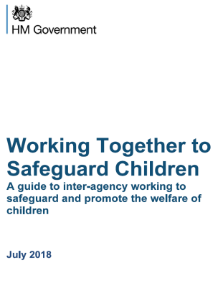
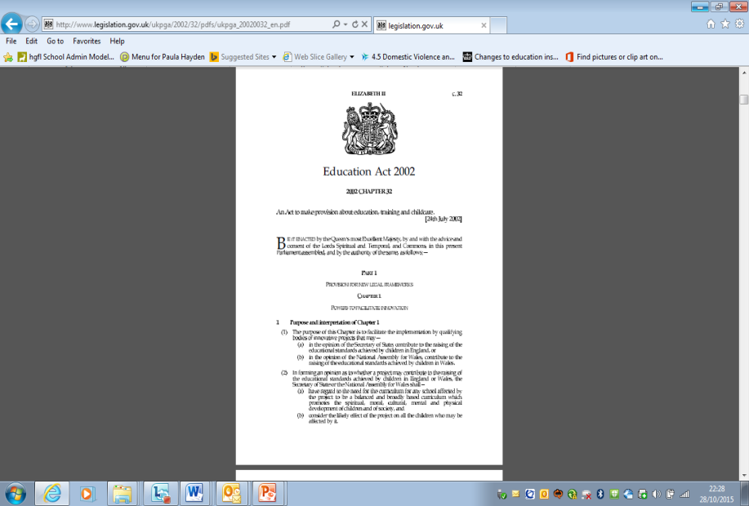
The law / safeguarding framework
National legislation and statutory guidance
Legal Duty: Section 175/157 Education Act 2002
PART 1
Notes:
Legal Duty
Under Section 175 / 157 of the 2002 Education Act, Local Authorities and school Governing Bodies have a statutory duty to safeguard children and are legally accountable for the safeguarding arrangements they make.
Government Guidance
WTTSC 2018
Sets out how organisations and individuals should work together to safeguard and promote the welfare of children and young people in accordance with the Children Act 1989 and the Children Act 2004.
KCSIE 2019 ( please note that although this guidance says ‘draft’ the hard copy of this will be on the DfE website from September 2019)
This is statutory guidance from the Department for Education. Schools and colleges must have regard to it when carrying out their duties to safeguard and promote the welfare of children.
This document contains information on what schools and colleges should do and sets out the legal duties with which schools and colleges must comply.
Staff must read PART 1 of KCSIE & should read Annex A (Annex B contains information about DSPs job description which they should be aware of)

Slide 4
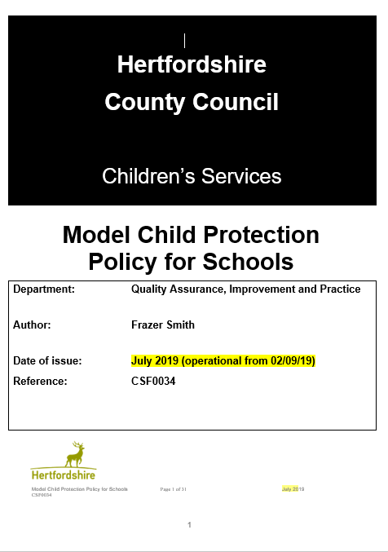
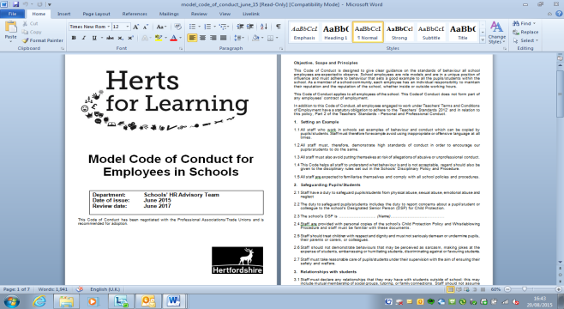
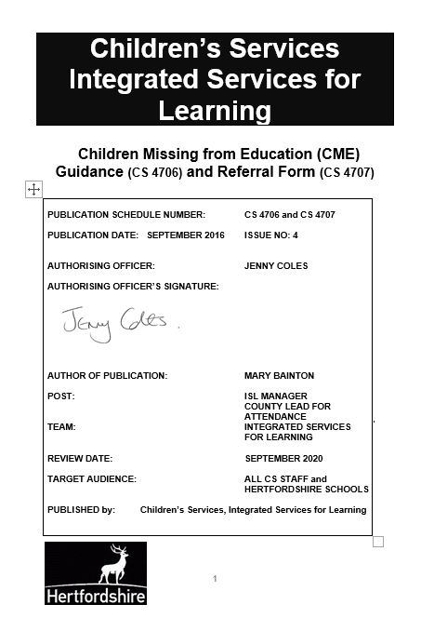
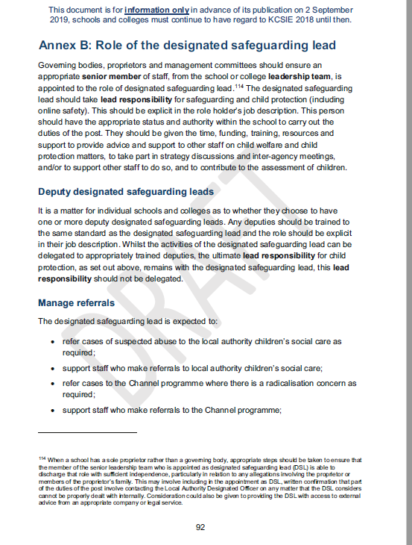
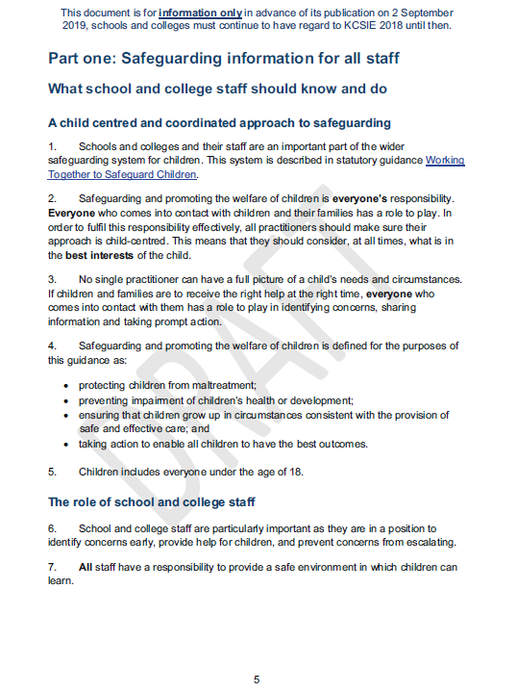
School policies, procedures and Guidance
Notes:
YOUR SETTING’S POLICY, PROCEDURES AND GUIDANCE
Minimum documents to share at staff induction
Staff should have
CP policy,
Behaviour policy, code of conduct ,
Missing from education procedures
Role of DSP ( ANNEX B KCSiE)
Part one of KCSiE 2019
There will be other safeguarding related policies that you will be expected to have read, e.g. whistleblowing. The Role of the DSP is defined in the cp policy (if you use HCC proforma).

Slide 5
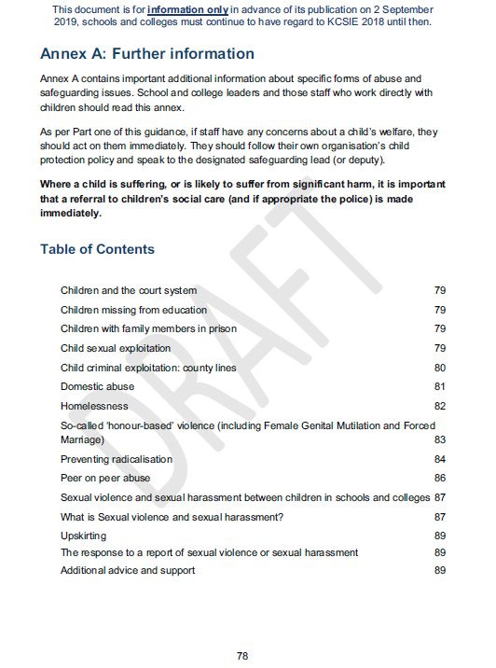
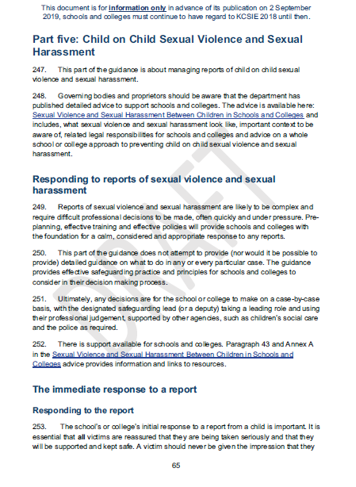


Specific circumstances and contextual safeguarding
Notes:
YOUR SETTING’S POLICY, PROCEDURES AND GUIDANCE - Specific circumstances and contextual safeguarding
Emphasis that
Annex A specific safeguarding circumstances - Mandatory duty to report Female genital mutilation and also prevent duty
Part five, Child on Child sexual violence – reporting peer on peer abuse

Slide 6


Inspection – KCSIE 2019
Inspectors also want to be assured that ‘peer on peer’ abuse is addressed through clear training, policies and procedures. Another addition emphasises the need for staff to understand how to handle reports of sexual violence and harassment in line with DfE guidance. Also. Staff to be able to identify learners who may need support with their mental health.
Notes:
Yael will provide presentation.

Slide 7
Safeguarding Framework
Safeguarding and promoting the welfare of children is everyone’s
responsibility. Everyone who comes into contact with children and
their families has a role to play. In order to fulfil this responsibility
effectively, all professionals should make sure their approach is
child-centered. This means that they should consider, at all times,
what is in the best interests of the child.
Keeping Children Safe in Education (DfE, Sept 2019)
Notes:
What school and college staff should know and do
A child centered and coordinated approach to safeguarding
1. Schools and colleges and their staff are an important part of the wider safeguarding system for children. This system is described in statutory guidance Working together to safeguard children.
2. Safeguarding and promoting the welfare of children is everyone’s responsibility. Everyone who comes into contact with children and their families has a role to play. In order to fulfil this responsibility effectively, all professionals should make sure their approach is child-centered. This means that they should consider, at all times, what is in the best interests of the child.
3. No single professional can have a full picture of a child’s needs and circumstances. If children and families are to receive the right help at the right time, everyone who comes into contact with them has a role to play in identifying concerns, sharing information and taking prompt action.
4. Safeguarding and promoting the welfare of children is defined for the purposes of this guidance as:
• protecting children from maltreatment;
• preventing impairment of children’s health or development;
• ensuring that children grow up in circumstances consistent with the provision of safe and effective care; and
• taking action to enable all children to have the best outcomes.
5. Children includes everyone under the age of 18.

Slide 8
Abuse/Neglect is….
All forms of maltreatment of a child. Somebody may abuse or neglect a child by inflicting harm or by failing to act to prevent harm.
Children may be abused:
In a family or
an institutional or
community setting by those known to them or, more rarely, by others.
Abuse can take place:
online, or technology may be used to facilitate offline abuse
Directly
They may be abused by:
an adult or adults or
another child or children.

Slide 9
What indicators of abuse should staff look out for?
Physical abuse
Emotional abuse
Neglect
Sexual abuse
Exercise
‘In pairs or groups discuss what are the indicators of the four categories of abuse and what is the impact’?
Notes:
Exercise, ask staff to discuss what the indictors would be for each category and what they think the impact is? Refer them to either KCSiE part one or their schools CP policy
17. All school and college staff members should be aware of the types of abuse and neglect so that they are able to identify cases of children who may be in need of help or protection. Types of abuse and neglect, and examples of safeguarding issues are described in paragraphs 35-44 of this guidance.
18. Departmental advice What to do if you are worried a child is being abused- Advice for practitioners provides more information on understanding and identifying abuse and neglect. Examples of potential signs of abuse and neglect are highlighted throughout the advice and will be particularly helpful for school and college staff. The NSPCC website also provides useful additional information on types of abuse and what to look out for.
19. Staff members working with children are advised to maintain an attitude of ‘it could happen here’ where safeguarding is concerned. When concerned about the welfare of a child, staff members should always act in the best interests of the child.
20. Knowing what to look for is vital to the early identification of abuse and neglect. If staff members are unsure, they should always speak to the designated safeguarding lead.
What school and college staff should do if they have concerns about a child
21. If staff members have any concerns about a child (as opposed to a child being in immediate danger - see paragraph 28) they will need to decide what action to take. Where possible, there should be a conversation with the designated safeguarding lead to agree a course of action, although any staff member can make a referral to children’s social care. Other options could include referral to specialist services or early help services and should be made in accordance with the referral threshold set by the Local Safeguarding Children Board.

Slide 10
Physical Abuse
A form of abuse which may involve hitting, shaking, throwing, poisoning, burning or scalding, drowning, suffocating or otherwise causing physical harm to a child.
Physical harm may also be caused when a parent or carer fabricates the symptoms of, or deliberately induces, illness in a child.

Slide 11
Possible indicators of Physical abuse
Unexplained injuries
Untreated injuries
Injuries on parts of body where accidental injury is unlikely
Hand or finger marked bruising; cigarette burn or bite marks
Scalds, esp. with upward splash marks, or rings where made to sit or stand in very hot water
Reluctant for parents to be contacted
Aggressive behaviour and temper
Child who shows fear of going home or runs away
Child flinches when approached/touched
Reluctance to get undressed for sporting activities
Covering arms/legs even when hot
Overly compliant to parents/carers

Slide 12
Emotional Abuse
Emotional abuse is the persistent emotional maltreatment of a child such as to cause severe and persistent adverse effects on the child’s emotional development.
Notes:
Emotional abuse: the persistent emotional maltreatment of a child such as to cause severe and adverse effects on the child’s emotional development. It may involve conveying to a child that they are worthless or unloved, inadequate, or valued only insofar as they meet the needs of another person. It may include not giving the child opportunities to express their views, deliberately silencing them or ‘making fun’ of what they say or how they communicate. It may feature age or developmentally inappropriate expectations being imposed on children. These may include interactions that are beyond a child’s developmental capability as well as overprotection and limitation of exploration and learning, or preventing the child from participating in normal social interaction. It may involve seeing or hearing the ill-treatment of another. It may involve serious bullying (including cyberbullying), causing children frequently to feel frightened or in danger, or the exploitation or corruption of children. Some level of emotional abuse is involved in all types of maltreatment of a child, although it may occur alone.

Slide 13
Possible indicators of Emotional abuse
Failure to grow or to thrive (particularly if child thrives away from home
Sudden speech disorders
Delayed development, either physical or emotional
Compulsive nervous behaviours such as hair twisting or rocking
An unwillingness or inability to play
Excessive fear of making mistakes
Self-harm or mutilation
Excessive deference towards others, especially adults
Excessive lack of confidence, and need for approval, attention and affection
Inability to cope with praise

Slide 14
Neglect
The persistent failure to meet a child’s basic physical and/or psychological needs, likely to result in the serious impairment of the child’s health or development.
Neglect may occur during pregnancy, for example, as a result of maternal substance abuse. Once a child is born, neglect may involve a parent or carer failing to: provide adequate food, clothing and shelter (including exclusion from home or abandonment); protect a child from physical and emotional harm or danger; ensure adequate supervision (including the use of inadequate care-givers); or ensure access to appropriate medical care or treatment. It may also include neglect of, or unresponsiveness to, a child’s basic emotional needs.

Slide 15
Possible indicators of Neglect
Dirty bedroom, no sheets on bed, inappropriate sleeping place
Being unkempt, dirty or smelly
Loss of weight or constantly being underweight
Dressed inappropriately for the weather conditions
Learning disabilities due to poor brain development
Untreated medical conditions
Being tired all the time
Frequently missing school or being late
Failing to keep medical appointments
Psycho-social development, depression, psychiatric illnesses & personality disorders
Being left unsupervised regularly

Slide 16
Sexual Abuse
Sexual abuse involves forcing or enticing a child or young person to take part in sexual activities, whether or not the child is aware of what is happening.
Non-contact activities, such as involving children in looking at, or in the production of, sexual images, watching sexual activities, encouraging children to behave in sexually inappropriate ways, or grooming a child in preparation for abuse (including on line).
Sexual abuse is not solely perpetrated by adult males. Women can also commit acts of sexual abuse, as can other children.
Notes:
Physical contact, including:
assault by penetration (for example, rape or oral sex)
non-penetrative acts such as masturbation, kissing, rubbing and touching outside of clothing.
Non-contact activities, such as:
involving children in looking at, or in the production of sexual images
watching sexual activities
encouraging children to behave in sexually inappropriate ways
grooming a child (including online)

Slide 17
Possible indicators of Sexual abuse
Sudden unexplained changes in behaviour
Apparent fear of someone
Being sexually coercive with other children
Nightmares or bedwetting
Self-harm, self-mutilation, suicide attempts, abuse of drugs/alcohol, eating problems (anorexia /bulimia/overeating)
Sexualised behaviour or knowledge, drawings, language
Running away from home
Pain, itching, bruising or bleeding in genital or anal areas
Any sexually transmitted infection
Recurrent genital discharge or urinary tract infections without apparent cause
Stomach pains
Discomfort when child is walking or sitting down
Pregnancy

Slide 18

What specific forms of abuse and safeguarding issues are set out in Annex A KCSiE 2019?
Children in the court system
Children missing from education
Children with family members in prison
Child sexual exploitation
Domestic abuse
Homelessness
So- called ‘honour- based 'violence ( including
Female genital mutilation and forced marriage
Preventing radicalisation
Peer on peer abuse
Sexual violence and sexual harassment between children in schools and colleges
What is sexual violence and sexual harassment?
Up skirting
The response to a report of sexual violence or sexual harassment
Additional advice and support

Slide 19
Safeguarding Role of School Staff
Recognise 
Respond 
Investigate x
Attempt to resolve x
Notes:
SAFEGUARDING ROLE OF SCHOOL STAFF
Recognise ✓
Staff need to recognise when they are concerned about a child. Being able to recognise concerns, means being familiar with the indicators of abuse
Respond ✓
Staff must respond to a concern about a child by passing the information to their Designated Senior Person (DSP) or Deputy DSP without delay. Staff must then make a written record of their concern as soon as possible and pass this to the DSP.
Investigate ✗
Staff are not responsible for investigating concerns about a child. Investigating includes in depth questioning of a child, colleagues, parents, physically examining children, taking photographs of injuries. Investigating does not mean that staff cannot talk to a child, colleagues or parents, but it is important that this is done in a non-leading way that would not compromise any formal investigation.
Attempt to resolve ✗
Staff should not attempt to resolve the situation themselves e.g. make and act upon decisions about how they think the matter should be dealt with. This kind of action fails to take account of any other information that may be held about the child e.g. other concerns of which the DSP is aware.

Slide 20
Talking and Listening to Children
Do:
Be approachable
Listen carefully, uncritically and at the child’s pace
Take what is said seriously
Clarify essential information
Reassure
Tell the child what will happen next
Tell the Designated Senior Person without delay
Record
Do Not:
Investigate
Try to resolve
Promise confidentiality
Make assumptions
Notes:
Listening openly to children is at the heart of safeguarding and promoting children’s well-being and protection. It covers a whole range of behaviours and situations.
It starts with an ethos in school which helps children to feel safe and able to talk.
Listening isn’t the simple process we might think it is. Children often drip feed us information and test us out to see if we can hear and if they will be believed
We all have our own filters but some we should be aware of are those around race, culture, class and myths around disability.
So we need to be approachable
Listen carefully, uncritically and at the child’s pace
Take what is said seriously
Clarify essential information
Reassure
Tell the child what will happen next
Tell your DSP without delay
And what we mustn’t do is
Investigate
Try to resolve
Promise confidentiality
Make assumptions
Importance of listening to children and taking what they say seriously – not staff’s place to make judgements about the validity or truth of what they are hearing.

Slide 21
Recording
Child’s name and date of birth
Date and time of the concern
Factual account of what happened, where and who was present using the child’s own words
Any opinion / interpretation needs to be explained
Your response
Printed name and signature of person making the record
Job title of person making the record
Date and time of the record
Notes:
Provide the member of staff with a blank copy of the Record of Concern form (available on the HGfL
http://www.thegrid.org.uk/info/welfare/child_protection/proformas/index.shtml) so they know what format they must use to record safeguarding concerns. Advise the member of staff where these forms are kept.
Factual account:
nature of the concern
where the information came from
if the child has an injury where is it, what does it look like, does the child
appear in pain
child’s account in their own words, method of communication
other’s accounts
witnesses
questions asked of child and/or others
what action was taken by you or others

Slide 22
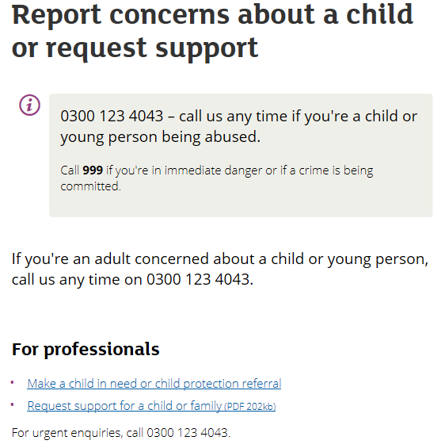
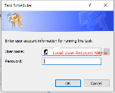
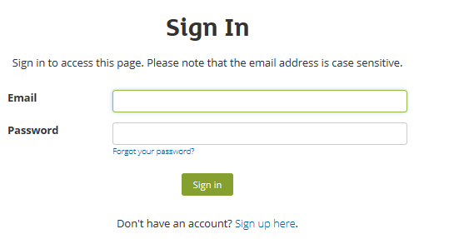
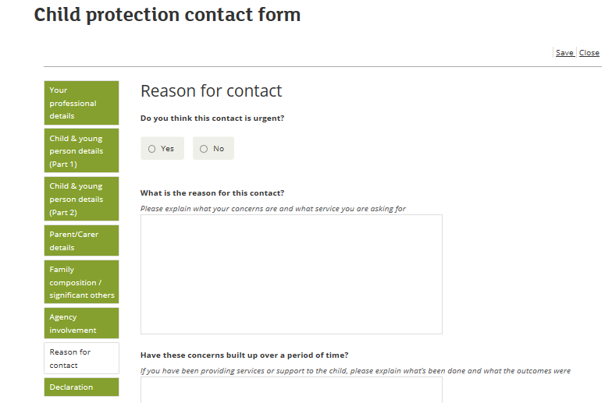



‘’ Any one can report child protection concerns’
Child Protection Contact Form - How to make a child protection contact to Hertfordshire Children’s Services.
The form will be located online at www.hertfordshire.gov.uk/childprotection
This Photo by Unknown Author is licensed under CC BY-SA-NC
Notes:
Child Protection Contact Form
How to make a child protection contact to Hertfordshire Children’s Services.
The form will be located online at www.hertfordshire.gov.uk/childprotection
1. You Can call directly
2. Report your concern on line following the process
3, Create an account
4 Fill out the form recording the concerns you have
Partnership Agencies Briefing – Child Protection Contact Form
How to make a child protection contact to Hertfordshire Children’s Services.
Hertfordshire have developed a new online form which will revolutionise how professionals make contacts about children. To ensure this project delivered what you wanted, we talked to Education, Health, Probation, Childrens Centres and Police leads to agree what the user needs were.
You told us you wanted the following:
I want to know my contact has been sent, received and stored securely.
I want my contact handled quickly and effectively by the right team.
I want the ability to save and print a copy of the contact for my records.
I want to be able to attach documents to the contact.
I will be given a ref number to use at a later date if I need it.
From the 28th May 2019 the new form will achieve all of these outcomes and more!
Our aim;
To provide you with a user friendly experience.
To give you a simplified process and structured format for informing us of concerns about a child.
To reduce the amount of repeat or chase up enquiries you have to make.
To inform you what we need to progress a contact into a referral.
Benefits – We currently receive approximately 9,000 enquiries each month by phone and e-mail. We anticipate this number reducing over time!
How to access/use the form:
The form will be located online at www.hertfordshire.gov.uk/childprotection
You must create an account first. This is a simple process to sign up.
Departments can choose how many accounts they need.
Once signed up, you can submit as many contacts as needed on the one account.
There are 8 sections to the form, ranging from “professional contact details” through to “reason for the contact”.
There are mandatory fields, meaning we need this information from you. You will not be able to submit the form until we have this information.
Once submitted, you will receive a reference number which is unique to the contact made, you can track your contact using the 03001234043 number.
*Watch this space for further developments of this Contact Form*
Refer to this link to watch our simple guidance video and to learn more about the form.

Slide 23
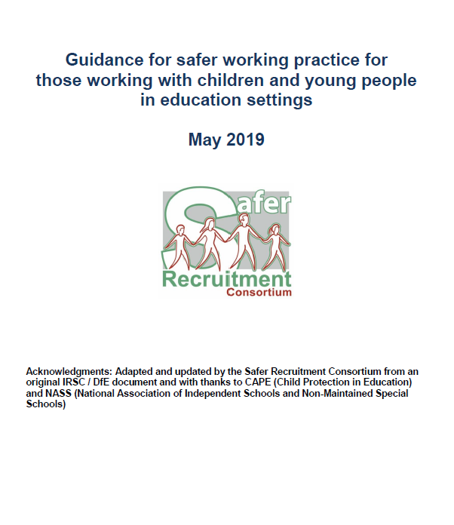
Safe Working Practice
All staff should clearly understand the need to
maintain appropriate professional boundaries
in their dealings with young people.
An ongoing culture of vigilance should be
maintained within schools so that poor or unsafe
practice is identified at the earliest opportunity.
http://www.thegrid.org.uk/info/welfare/child_protection/allegations/safe.shtmlp
Notes:
DSP to advise member of staff about the ethos of the school and the expectations on staff about safe and appropriate professional conduct.
Also how poor, unsafe and unprofessional conduct is dealt with.

Slide 24
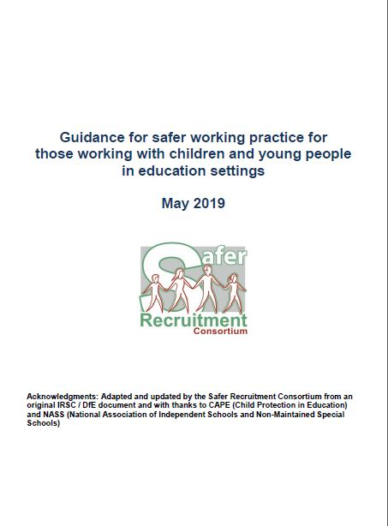
Updated Guidance
12. Communication with children
It has long been clear that staff should not communicate with pupils outside the context of their work. The new guidance seeks to strengthen this by adding that adults should 'turn off 3G/4G data access on school premises’.
21. Transporting pupils
'Staff should not offer lifts to pupils unless the need for this has been agreed by a manager...[and there should be]...at least one adult additional to the driver acting as an escort.'
Notes:
Guidance for Safer Working Practices (May 2019)(Safer Recruitment Consortium)
The Safer Recruitment Consortium have just released an updated version of the Guidance for Safer Working Practices. This document is non-statutory, but is very useful never-the-less and I think it is well-worth a read. It makes a good starting point for a staff behaviour policy.
Keeping Children Safe in Education says that schools should have 'A staff behaviour policy (sometimes called the code of conduct) which should, amongst other things, include - acceptable use of technologies, staff/pupil relationships and communications including the use of social media'. (Paragraph 55) All staff should be aware of the code of conduct and have it explained to them during induction.
The Guidance for Safer Working Practices covers all the required aspects of the staff behaviour policy. The document is particularly useful in that it has many examples of what the guidance means. The new version has a forward by Nadhim Zahawi, Parliamentary Under-Secretary for Children and Families.
The guidance was last issued in October 2015, and there have been a few changes since then that are reflected in the sections identified below:
6. Confidentiality
Since the last edition of Safer Working Practices, the new Data Protection Act (DPA) has come into force bringing with the GDPR. The guidance says that school leaders should ensure that all staff who need to share ‘special category personal data’ are aware that the DPA 2018 contains ‘safeguarding of children and individuals at risk’ as a processing condition. This allows practitioners to share information without consent, if it is not possible to gain consent, it cannot be reasonably expected that a practitioner gains consent or if to gain consent would place a child at risk
7. Standards of Behaviour
This section includes the changes to The Childcare (Disqualification) Regulations 2018, as reported widely last year.
12. Communication with children
It has long been clear that staff should not communicate with pupils outside the context of their work. The new guidance seeks to strengthen this by adding that adults should 'turn off 3G/4G data access on school premises'.
21. Transporting pupils
'Staff should not offer lifts to pupils unless the need for this has been agreed by a manager...[and there should be]...at least one adult additional to the driver acting as an escort.'
22. Educational visits
Staff responsible for organising educational visits should be familiar with the Department for Education’s advice on Health and Safety (updated November 2018) available at https://www.gov.uk/government/publications/health-and-safety-advice-for-schools/responsibilities-and-duties-for-schools
School trips and outdoor learning activities (HSE) http://www.hse.gov.uk/services/education/school-trips.pdf
24. Photography, videos and other images / media
The message is clear here, that adults should not take images of a child’s injury, bruising or similar (e.g. following a disclosure of abuse) even if requested by children’s social care; or make audio recordings of a child’s disclosure
28. Curriculum
'The curriculum can sometimes include or lead to unplanned discussion about subject matter of a sexually explicit, political or otherwise sensitive nature. Responding to children’s questions requires careful judgement and staff should take guidance in these circumstances from the Designated Safeguarding Lead.'
This means that 'care should be taken to comply with the setting’s policy on spiritual, moral, social, cultural (SMSC) [education] which should promote fundamental British values and be rigorously reviewed to ensure it is lawful and consistently applied. Staff should also comply at all times with the policy for relationships and sex education (RSE)'.
18. Sexual conduct
All staff should be aware that under the Sexual Offences Act 2003, it is a crime for an adult in a position of trust to engage in sexual activity with a person under the age of 18. Although this is not new information, teachers are still being prohibited from teaching for these offences.
Teachers are in a position of trust, along with people who look after, or are responsible for young people such medical professionals, foster carers and social workers.
Guidance for Safer Working Practices (May 2019)(Safer Recruitment Consortium)
The Safer Recruitment Consortium have just released an updated version of the Guidance for Safer Working Practices. This document is non-statutory, but is very useful never-the-less and I think it is well-worth a read. It makes a good starting point for a staff behaviour policy.
Keeping Children Safe in Education says that schools should have 'A staff behaviour policy (sometimes called the code of conduct) which should, amongst other things, include - acceptable use of technologies, staff/pupil relationships and communications including the use of social media'. (Paragraph 55) All staff should be aware of the code of conduct and have it explained to them during induction.
The Guidance for Safer Working Practices covers all the required aspects of the staff behaviour policy. The document is particularly useful in that it has many examples of what the guidance means. The new version has a forward by Nadhim Zahawi, Parliamentary Under-Secretary for Children and Families.
The guidance was last issued in October 2015, and there have been a few changes since then that are reflected in the sections identified below:
6. Confidentiality
Since the last edition of Safer Working Practices, the new Data Protection Act (DPA) has come into force bringing with the GDPR. The guidance says that school leaders should ensure that all staff who need to share ‘special category personal data’ are aware that the DPA 2018 contains ‘safeguarding of children and individuals at risk’ as a processing condition. This allows practitioners to share information without consent, if it is not possible to gain consent, it cannot be reasonably expected that a practitioner gains consent or if to gain consent would place a child at risk
7. Standards of Behaviour
This section includes the changes to The Childcare (Disqualification) Regulations 2018, as reported widely last year.
12. Communication with children
It has long been clear that staff should not communicate with pupils outside the context of their work. The new guidance seeks to strengthen this by adding that adults should 'turn off 3G/4G data access on school premises'.
21. Transporting pupils
'Staff should not offer lifts to pupils unless the need for this has been agreed by a manager...[and there should be]...at least one adult additional to the driver acting as an escort.'
22. Educational visits
Staff responsible for organising educational visits should be familiar with the Department for Education’s advice on Health and Safety (updated November 2018) available at https://www.gov.uk/government/publications/health-and-safety-advice-for-schools/responsibilities-and-duties-for-schools
School trips and outdoor learning activities (HSE) http://www.hse.gov.uk/services/education/school-trips.pdf
24. Photography, videos and other images / media
The message is clear here, that adults should not take images of a child’s injury, bruising or similar (e.g. following a disclosure of abuse) even if requested by children’s social care; or make audio recordings of a child’s disclosure
28. Curriculum
'The curriculum can sometimes include or lead to unplanned discussion about subject matter of a sexually explicit, political or otherwise sensitive nature. Responding to children’s questions requires careful judgement and staff should take guidance in these circumstances from the Designated Safeguarding Lead.'
This means that 'care should be taken to comply with the setting’s policy on spiritual, moral, social, cultural (SMSC) [education] which should promote fundamental British values and be rigorously reviewed to ensure it is lawful and consistently applied. Staff should also comply at all times with the policy for relationships and sex education (RSE)'.
18. Sexual conduct
All staff should be aware that under the Sexual Offences Act 2003, it is a crime for an adult in a position of trust to engage in sexual activity with a person under the age of 18. Although this is not new information, teachers are still being prohibited from teaching for these offences.
Teachers are in a position of trust, along with people who look after, or are responsible for young people such medical professionals, foster carers and social workers.

Slide 25

Updated Guidance
24. Photography, videos and other images / media
The message is clear here, that adults should not take images of a child’s injury, bruising or similar (e.g. following a disclosure of abuse) even if requested by children’s social care; or make audio recordings of a child’s disclosure
28. Curriculum
'The curriculum can sometimes include or lead to unplanned discussion about subject matter of a sexually explicit, political or otherwise sensitive nature. Responding to children’s questions requires careful judgement and staff should take guidance in these circumstances from the Designated Safeguarding Lead.
Notes:
Guidance for Safer Working Practices (May 2019)(Safer Recruitment Consortium)
The Safer Recruitment Consortium have just released an updated version of the Guidance for Safer Working Practices. This document is non-statutory, but is very useful never-the-less and I think it is well-worth a read. It makes a good starting point for a staff behaviour policy.
Keeping Children Safe in Education says that schools should have 'A staff behaviour policy (sometimes called the code of conduct) which should, amongst other things, include - acceptable use of technologies, staff/pupil relationships and communications including the use of social media'. (Paragraph 55) All staff should be aware of the code of conduct and have it explained to them during induction.
The Guidance for Safer Working Practices covers all the required aspects of the staff behaviour policy. The document is particularly useful in that it has many examples of what the guidance means. The new version has a forward by Nadhim Zahawi, Parliamentary Under-Secretary for Children and Families.
The guidance was last issued in October 2015, and there have been a few changes since then that are reflected in the sections identified below:
6. Confidentiality
Since the last edition of Safer Working Practices, the new Data Protection Act (DPA) has come into force bringing with the GDPR. The guidance says that school leaders should ensure that all staff who need to share ‘special category personal data’ are aware that the DPA 2018 contains ‘safeguarding of children and individuals at risk’ as a processing condition. This allows practitioners to share information without consent, if it is not possible to gain consent, it cannot be reasonably expected that a practitioner gains consent or if to gain consent would place a child at risk
7. Standards of Behaviour
This section includes the changes to The Childcare (Disqualification) Regulations 2018, as reported widely last year.
12. Communication with children
It has long been clear that staff should not communicate with pupils outside the context of their work. The new guidance seeks to strengthen this by adding that adults should 'turn off 3G/4G data access on school premises'.
21. Transporting pupils
'Staff should not offer lifts to pupils unless the need for this has been agreed by a manager...[and there should be]...at least one adult additional to the driver acting as an escort.'
22. Educational visits
Staff responsible for organising educational visits should be familiar with the Department for Education’s advice on Health and Safety (updated November 2018) available at https://www.gov.uk/government/publications/health-and-safety-advice-for-schools/responsibilities-and-duties-for-schools
School trips and outdoor learning activities (HSE) http://www.hse.gov.uk/services/education/school-trips.pdf
24. Photography, videos and other images / media
The message is clear here, that adults should not take images of a child’s injury, bruising or similar (e.g. following a disclosure of abuse) even if requested by children’s social care; or make audio recordings of a child’s disclosure
28. Curriculum
'The curriculum can sometimes include or lead to unplanned discussion about subject matter of a sexually explicit, political or otherwise sensitive nature. Responding to children’s questions requires careful judgement and staff should take guidance in these circumstances from the Designated Safeguarding Lead.'
This means that 'care should be taken to comply with the setting’s policy on spiritual, moral, social, cultural (SMSC) [education] which should promote fundamental British values and be rigorously reviewed to ensure it is lawful and consistently applied. Staff should also comply at all times with the policy for relationships and sex education (RSE)'.
18. Sexual conduct
All staff should be aware that under the Sexual Offences Act 2003, it is a crime for an adult in a position of trust to engage in sexual activity with a person under the age of 18. Although this is not new information, teachers are still being prohibited from teaching for these offences.
Teachers are in a position of trust, along with people who look after, or are responsible for young people such medical professionals, foster carers and social workers.
Guidance for Safer Working Practices (May 2019)(Safer Recruitment Consortium)
The Safer Recruitment Consortium have just released an updated version of the Guidance for Safer Working Practices. This document is non-statutory, but is very useful never-the-less and I think it is well-worth a read. It makes a good starting point for a staff behaviour policy.
Keeping Children Safe in Education says that schools should have 'A staff behaviour policy (sometimes called the code of conduct) which should, amongst other things, include - acceptable use of technologies, staff/pupil relationships and communications including the use of social media'. (Paragraph 55) All staff should be aware of the code of conduct and have it explained to them during induction.
The Guidance for Safer Working Practices covers all the required aspects of the staff behaviour policy. The document is particularly useful in that it has many examples of what the guidance means. The new version has a forward by Nadhim Zahawi, Parliamentary Under-Secretary for Children and Families.
The guidance was last issued in October 2015, and there have been a few changes since then that are reflected in the sections identified below:
6. Confidentiality
Since the last edition of Safer Working Practices, the new Data Protection Act (DPA) has come into force bringing with the GDPR. The guidance says that school leaders should ensure that all staff who need to share ‘special category personal data’ are aware that the DPA 2018 contains ‘safeguarding of children and individuals at risk’ as a processing condition. This allows practitioners to share information without consent, if it is not possible to gain consent, it cannot be reasonably expected that a practitioner gains consent or if to gain consent would place a child at risk
7. Standards of Behaviour
This section includes the changes to The Childcare (Disqualification) Regulations 2018, as reported widely last year.
12. Communication with children
It has long been clear that staff should not communicate with pupils outside the context of their work. The new guidance seeks to strengthen this by adding that adults should 'turn off 3G/4G data access on school premises'.
21. Transporting pupils
'Staff should not offer lifts to pupils unless the need for this has been agreed by a manager...[and there should be]...at least one adult additional to the driver acting as an escort.'
22. Educational visits
Staff responsible for organising educational visits should be familiar with the Department for Education’s advice on Health and Safety (updated November 2018) available at https://www.gov.uk/government/publications/health-and-safety-advice-for-schools/responsibilities-and-duties-for-schools
School trips and outdoor learning activities (HSE) http://www.hse.gov.uk/services/education/school-trips.pdf
24. Photography, videos and other images / media
The message is clear here, that adults should not take images of a child’s injury, bruising or similar (e.g. following a disclosure of abuse) even if requested by children’s social care; or make audio recordings of a child’s disclosure
28. Curriculum
'The curriculum can sometimes include or lead to unplanned discussion about subject matter of a sexually explicit, political or otherwise sensitive nature. Responding to children’s questions requires careful judgement and staff should take guidance in these circumstances from the Designated Safeguarding Lead.'
This means that 'care should be taken to comply with the setting’s policy on spiritual, moral, social, cultural (SMSC) [education] which should promote fundamental British values and be rigorously reviewed to ensure it is lawful and consistently applied. Staff should also comply at all times with the policy for relationships and sex education (RSE)'.
18. Sexual conduct
All staff should be aware that under the Sexual Offences Act 2003, it is a crime for an adult in a position of trust to engage in sexual activity with a person under the age of 18. Although this is not new information, teachers are still being prohibited from teaching for these offences.
Teachers are in a position of trust, along with people who look after, or are responsible for young people such medical professionals, foster carers and social workers.

Slide 26

Updated Guidance
6. Confidentiality
Since the last edition of Safer Working Practices, the new Data Protection Act (DPA) has come into force bringing with the GDPR. The guidance says that school leaders should ensure that all staff who need to share ‘special category personal data’ are aware that the DPA 2018 contains ‘safeguarding of children and individuals at risk’ as a processing condition. This allows practitioners to share information without consent, if it is not possible to gain consent, it cannot be reasonably expected that a practitioner gains consent or if to gain consent would place a child at risk
Notes:
Guidance for Safer Working Practices (May 2019)(Safer Recruitment Consortium)
The Safer Recruitment Consortium have just released an updated version of the Guidance for Safer Working Practices. This document is non-statutory, but is very useful never-the-less and I think it is well-worth a read. It makes a good starting point for a staff behaviour policy.
Keeping Children Safe in Education says that schools should have 'A staff behaviour policy (sometimes called the code of conduct) which should, amongst other things, include - acceptable use of technologies, staff/pupil relationships and communications including the use of social media'. (Paragraph 55) All staff should be aware of the code of conduct and have it explained to them during induction.
The Guidance for Safer Working Practices covers all the required aspects of the staff behaviour policy. The document is particularly useful in that it has many examples of what the guidance means. The new version has a forward by Nadhim Zahawi, Parliamentary Under-Secretary for Children and Families.
The guidance was last issued in October 2015, and there have been a few changes since then that are reflected in the sections identified below:
6. Confidentiality
Since the last edition of Safer Working Practices, the new Data Protection Act (DPA) has come into force bringing with the GDPR. The guidance says that school leaders should ensure that all staff who need to share ‘special category personal data’ are aware that the DPA 2018 contains ‘safeguarding of children and individuals at risk’ as a processing condition. This allows practitioners to share information without consent, if it is not possible to gain consent, it cannot be reasonably expected that a practitioner gains consent or if to gain consent would place a child at risk
7. Standards of Behaviour
This section includes the changes to The Childcare (Disqualification) Regulations 2018, as reported widely last year.
12. Communication with children
It has long been clear that staff should not communicate with pupils outside the context of their work. The new guidance seeks to strengthen this by adding that adults should 'turn off 3G/4G data access on school premises'.
21. Transporting pupils
'Staff should not offer lifts to pupils unless the need for this has been agreed by a manager...[and there should be]...at least one adult additional to the driver acting as an escort.'
22. Educational visits
Staff responsible for organising educational visits should be familiar with the Department for Education’s advice on Health and Safety (updated November 2018) available at https://www.gov.uk/government/publications/health-and-safety-advice-for-schools/responsibilities-and-duties-for-schools
School trips and outdoor learning activities (HSE) http://www.hse.gov.uk/services/education/school-trips.pdf
24. Photography, videos and other images / media
The message is clear here, that adults should not take images of a child’s injury, bruising or similar (e.g. following a disclosure of abuse) even if requested by children’s social care; or make audio recordings of a child’s disclosure
28. Curriculum
'The curriculum can sometimes include or lead to unplanned discussion about subject matter of a sexually explicit, political or otherwise sensitive nature. Responding to children’s questions requires careful judgement and staff should take guidance in these circumstances from the Designated Safeguarding Lead.'
This means that 'care should be taken to comply with the setting’s policy on spiritual, moral, social, cultural (SMSC) [education] which should promote fundamental British values and be rigorously reviewed to ensure it is lawful and consistently applied. Staff should also comply at all times with the policy for relationships and sex education (RSE)'.
18. Sexual conduct
All staff should be aware that under the Sexual Offences Act 2003, it is a crime for an adult in a position of trust to engage in sexual activity with a person under the age of 18. Although this is not new information, teachers are still being prohibited from teaching for these offences.
Teachers are in a position of trust, along with people who look after, or are responsible for young people such medical professionals, foster carers and social workers.
Guidance for Safer Working Practices (May 2019)(Safer Recruitment Consortium)
The Safer Recruitment Consortium have just released an updated version of the Guidance for Safer Working Practices. This document is non-statutory, but is very useful never-the-less and I think it is well-worth a read. It makes a good starting point for a staff behaviour policy.
Keeping Children Safe in Education says that schools should have 'A staff behaviour policy (sometimes called the code of conduct) which should, amongst other things, include - acceptable use of technologies, staff/pupil relationships and communications including the use of social media'. (Paragraph 55) All staff should be aware of the code of conduct and have it explained to them during induction.
The Guidance for Safer Working Practices covers all the required aspects of the staff behaviour policy. The document is particularly useful in that it has many examples of what the guidance means. The new version has a forward by Nadhim Zahawi, Parliamentary Under-Secretary for Children and Families.
The guidance was last issued in October 2015, and there have been a few changes since then that are reflected in the sections identified below:
6. Confidentiality
Since the last edition of Safer Working Practices, the new Data Protection Act (DPA) has come into force bringing with the GDPR. The guidance says that school leaders should ensure that all staff who need to share ‘special category personal data’ are aware that the DPA 2018 contains ‘safeguarding of children and individuals at risk’ as a processing condition. This allows practitioners to share information without consent, if it is not possible to gain consent, it cannot be reasonably expected that a practitioner gains consent or if to gain consent would place a child at risk
7. Standards of Behaviour
This section includes the changes to The Childcare (Disqualification) Regulations 2018, as reported widely last year.
12. Communication with children
It has long been clear that staff should not communicate with pupils outside the context of their work. The new guidance seeks to strengthen this by adding that adults should 'turn off 3G/4G data access on school premises'.
21. Transporting pupils
'Staff should not offer lifts to pupils unless the need for this has been agreed by a manager...[and there should be]...at least one adult additional to the driver acting as an escort.'
22. Educational visits
Staff responsible for organising educational visits should be familiar with the Department for Education’s advice on Health and Safety (updated November 2018) available at https://www.gov.uk/government/publications/health-and-safety-advice-for-schools/responsibilities-and-duties-for-schools
School trips and outdoor learning activities (HSE) http://www.hse.gov.uk/services/education/school-trips.pdf
24. Photography, videos and other images / media
The message is clear here, that adults should not take images of a child’s injury, bruising or similar (e.g. following a disclosure of abuse) even if requested by children’s social care; or make audio recordings of a child’s disclosure
28. Curriculum
'The curriculum can sometimes include or lead to unplanned discussion about subject matter of a sexually explicit, political or otherwise sensitive nature. Responding to children’s questions requires careful judgement and staff should take guidance in these circumstances from the Designated Safeguarding Lead.'
This means that 'care should be taken to comply with the setting’s policy on spiritual, moral, social, cultural (SMSC) [education] which should promote fundamental British values and be rigorously reviewed to ensure it is lawful and consistently applied. Staff should also comply at all times with the policy for relationships and sex education (RSE)'.
18. Sexual conduct
All staff should be aware that under the Sexual Offences Act 2003, it is a crime for an adult in a position of trust to engage in sexual activity with a person under the age of 18. Although this is not new information, teachers are still being prohibited from teaching for these offences.
Teachers are in a position of trust, along with people who look after, or are responsible for young people such medical professionals, foster carers and social workers.

Slide 27
Updated Guidance
18. Sexual conduct
All staff should be aware that under the Sexual Offences Act 2003, it is a crime for an adult in a position of trust to engage in sexual activity with a person under the age of 18. Although this is not new information, teachers are still being prohibited from teaching for these offences.
Teachers are in a position of trust, along with people who look after, or are responsible for young people such medical professionals, foster carers and social workers.
Notes:
Guidance for Safer Working Practices (May 2019)(Safer Recruitment Consortium)
The Safer Recruitment Consortium have just released an updated version of the Guidance for Safer Working Practices. This document is non-statutory, but is very useful never-the-less and I think it is well-worth a read. It makes a good starting point for a staff behaviour policy.
Keeping Children Safe in Education says that schools should have 'A staff behaviour policy (sometimes called the code of conduct) which should, amongst other things, include - acceptable use of technologies, staff/pupil relationships and communications including the use of social media'. (Paragraph 55) All staff should be aware of the code of conduct and have it explained to them during induction.
The Guidance for Safer Working Practices covers all the required aspects of the staff behaviour policy. The document is particularly useful in that it has many examples of what the guidance means. The new version has a forward by Nadhim Zahawi, Parliamentary Under-Secretary for Children and Families.
The guidance was last issued in October 2015, and there have been a few changes since then that are reflected in the sections identified below:
6. Confidentiality
Since the last edition of Safer Working Practices, the new Data Protection Act (DPA) has come into force bringing with the GDPR. The guidance says that school leaders should ensure that all staff who need to share ‘special category personal data’ are aware that the DPA 2018 contains ‘safeguarding of children and individuals at risk’ as a processing condition. This allows practitioners to share information without consent, if it is not possible to gain consent, it cannot be reasonably expected that a practitioner gains consent or if to gain consent would place a child at risk
7. Standards of Behaviour
This section includes the changes to The Childcare (Disqualification) Regulations 2018, as reported widely last year.
12. Communication with children
It has long been clear that staff should not communicate with pupils outside the context of their work. The new guidance seeks to strengthen this by adding that adults should 'turn off 3G/4G data access on school premises'.
21. Transporting pupils
'Staff should not offer lifts to pupils unless the need for this has been agreed by a manager...[and there should be]...at least one adult additional to the driver acting as an escort.'
22. Educational visits
Staff responsible for organising educational visits should be familiar with the Department for Education’s advice on Health and Safety (updated November 2018) available at https://www.gov.uk/government/publications/health-and-safety-advice-for-schools/responsibilities-and-duties-for-schools
School trips and outdoor learning activities (HSE) http://www.hse.gov.uk/services/education/school-trips.pdf
24. Photography, videos and other images / media
The message is clear here, that adults should not take images of a child’s injury, bruising or similar (e.g. following a disclosure of abuse) even if requested by children’s social care; or make audio recordings of a child’s disclosure
28. Curriculum
'The curriculum can sometimes include or lead to unplanned discussion about subject matter of a sexually explicit, political or otherwise sensitive nature. Responding to children’s questions requires careful judgement and staff should take guidance in these circumstances from the Designated Safeguarding Lead.'
This means that 'care should be taken to comply with the setting’s policy on spiritual, moral, social, cultural (SMSC) [education] which should promote fundamental British values and be rigorously reviewed to ensure it is lawful and consistently applied. Staff should also comply at all times with the policy for relationships and sex education (RSE)'.
18. Sexual conduct
All staff should be aware that under the Sexual Offences Act 2003, it is a crime for an adult in a position of trust to engage in sexual activity with a person under the age of 18. Although this is not new information, teachers are still being prohibited from teaching for these offences.
Teachers are in a position of trust, along with people who look after, or are responsible for young people such medical professionals, foster carers and social workers.
Guidance for Safer Working Practices (May 2019)(Safer Recruitment Consortium)
The Safer Recruitment Consortium have just released an updated version of the Guidance for Safer Working Practices. This document is non-statutory, but is very useful never-the-less and I think it is well-worth a read. It makes a good starting point for a staff behaviour policy.
Keeping Children Safe in Education says that schools should have 'A staff behaviour policy (sometimes called the code of conduct) which should, amongst other things, include - acceptable use of technologies, staff/pupil relationships and communications including the use of social media'. (Paragraph 55) All staff should be aware of the code of conduct and have it explained to them during induction.
The Guidance for Safer Working Practices covers all the required aspects of the staff behaviour policy. The document is particularly useful in that it has many examples of what the guidance means. The new version has a forward by Nadhim Zahawi, Parliamentary Under-Secretary for Children and Families.
The guidance was last issued in October 2015, and there have been a few changes since then that are reflected in the sections identified below:
6. Confidentiality
Since the last edition of Safer Working Practices, the new Data Protection Act (DPA) has come into force bringing with the GDPR. The guidance says that school leaders should ensure that all staff who need to share ‘special category personal data’ are aware that the DPA 2018 contains ‘safeguarding of children and individuals at risk’ as a processing condition. This allows practitioners to share information without consent, if it is not possible to gain consent, it cannot be reasonably expected that a practitioner gains consent or if to gain consent would place a child at risk
7. Standards of Behaviour
This section includes the changes to The Childcare (Disqualification) Regulations 2018, as reported widely last year.
12. Communication with children
It has long been clear that staff should not communicate with pupils outside the context of their work. The new guidance seeks to strengthen this by adding that adults should 'turn off 3G/4G data access on school premises'.
21. Transporting pupils
'Staff should not offer lifts to pupils unless the need for this has been agreed by a manager...[and there should be]...at least one adult additional to the driver acting as an escort.'
22. Educational visits
Staff responsible for organising educational visits should be familiar with the Department for Education’s advice on Health and Safety (updated November 2018) available at https://www.gov.uk/government/publications/health-and-safety-advice-for-schools/responsibilities-and-duties-for-schools
School trips and outdoor learning activities (HSE) http://www.hse.gov.uk/services/education/school-trips.pdf
24. Photography, videos and other images / media
The message is clear here, that adults should not take images of a child’s injury, bruising or similar (e.g. following a disclosure of abuse) even if requested by children’s social care; or make audio recordings of a child’s disclosure
28. Curriculum
'The curriculum can sometimes include or lead to unplanned discussion about subject matter of a sexually explicit, political or otherwise sensitive nature. Responding to children’s questions requires careful judgement and staff should take guidance in these circumstances from the Designated Safeguarding Lead.'
This means that 'care should be taken to comply with the setting’s policy on spiritual, moral, social, cultural (SMSC) [education] which should promote fundamental British values and be rigorously reviewed to ensure it is lawful and consistently applied. Staff should also comply at all times with the policy for relationships and sex education (RSE)'.
18. Sexual conduct
All staff should be aware that under the Sexual Offences Act 2003, it is a crime for an adult in a position of trust to engage in sexual activity with a person under the age of 18. Although this is not new information, teachers are still being prohibited from teaching for these offences.
Teachers are in a position of trust, along with people who look after, or are responsible for young people such medical professionals, foster carers and social workers.

Slide 28
Safe Working Practice
Key documentation in schools:
Safeguarding policies (child protection, safer recruitment, anti bullying, whistle blowing, e-safety and physical intervention)
Code of conduct/Staff Behaviour Policy
Staff handbook
‘Seek guidance from the senior leadership team’.
Notes:
Ensure that the member of staff is aware of these documents and how to access them.

Slide 29
Other areas of staff vulnerability
Physical contact
Control and physical intervention
Communication with a child, including e-safety
Intimate/personal care
One to one situations
Relationships
Notes:
Explain to the member of staff what some of the risks might be and what is expected in terms of staff conduct.

Slide 30
Abuse of Position of Trust
The Sexual Offences Act 2003 provides that it is an offence
for a person aged 18 or over intentionally to behave in certain
sexual ways in relation to a child aged under 18, where the
adult is in a position of trust in respect of the child.
Notes:
All staff working in a school, regardless of their role, are in a position of trust in relation to the children at that school. No member of staff should behave in a sexual way towards a child.
Certain sexual ways is defined as:
sexual activity with a child
causing or inciting a child to engage in sexual activity
sexual activity in the presence of a child
causing a child to watch a sexual act
A person is in a position of trust if they look after children under 18 who are in
education at an educational establishment and the child in question receives
education at that establishment. Someone receives "education at an
educational institution" if he is registered or enrolled there as a pupil or student
or is educated there by arrangement with the educational establishment at
which he is registered or enrolled
"Looks after" is defined as "regularly involved in caring for, training,
supervising or being in sole charge of" the other person and includes
circumstances where there is regular unsupervised contact. The contact can
be in person, or by any other means, such as on the telephone or over the
Internet.
The offence covers all children under 18, however it is principally designed to
protect young people aged 16 and 17 who, even though they are over the age
of consent for sexual activity, are considered to be vulnerable to sexual abuse
and exploitation from particular classes of persons who hold a position of trust
or authority in relation to them.

Slide 31
Allegations Against Staff/Volunteers
If staff/volunteers have safeguarding concerns, or an allegation is made about another member of staff (including volunteers) posing a risk of harm to children, then:
this should be referred to the headteacher or principal;
Where there are concerns/allegations about the headteacher or principal then:
This should be referred to the chair of governors, chair of the management committee or proprietor of an independent school; and
In the event of concerns/allegations about the headteacher, where the headteacher is also the sole proprietor of an independent school then:
This is to be reported directly to the designated officer(s) at the local authority, ( LADO) 03001234043.
Notes:
Duties as an employer and an employee
184. This part of the guidance is about managing cases of allegations that might indicate a person would pose a risk of harm90 if they continue to work in regular or close contact with children in their present position, or in any capacity. It should be used in respect of all cases in which it is alleged that a teacher or member of staff (including volunteers) in a school or college that provides education for children under 18 years of age has:
• behaved in a way that has harmed a child, or may have harmed a child;
• possibly committed a criminal offence against or related to a child; or
• behaved towards a child or children in a way that indicates he or she may pose a risk of harm to children.
185. This part of the guidance relates to members of staff and volunteers who are currently working in any school or college regardless of whether the school or college is where the alleged abuse took place. Allegations against a teacher who is no longer teaching should be referred to the police. Historical allegations of abuse should also be referred to the police.
186. Employers have a duty of care to their employees. They should ensure they provide effective support for anyone facing an allegation and provide the employee with a named contact if they are suspended. It is essential that any allegation of abuse made against a teacher or other member of staff or volunteer in a school or college is dealt with very quickly, in a fair and consistent way that provides effective protection for the child and, at the same time supports the person who is the subject of the allegation.

Slide 32
Concerns regarding safeguarding practice
All staff and volunteers should feel able to raise concerns about poor or unsafe practice and potential failures in the school or college’s safeguarding regime and know that such concerns will be taken seriously by the senior leadership team.
Appropriate whistleblowing procedures, which are suitably reflected in staff training and staff behaviour policies, should be in place for such concerns to be raised with the school or college’s senior leadership team.
Where a staff member feels unable to raise an issue with their employer, or feels that their genuine concerns are not being addressed, other whistleblowing channels may be open to them:
NSPCC Whistleblowing Helpline
0800 028 0285
help@nspcc.org.uk
Notes:
Duties as an employer and an employee
184. This part of the guidance is about managing cases of allegations that might indicate a person would pose a risk of harm90 if they continue to work in regular or close contact with children in their present position, or in any capacity. It should be used in respect of all cases in which it is alleged that a teacher or member of staff (including volunteers) in a school or college that provides education for children under 18 years of age has:
• behaved in a way that has harmed a child, or may have harmed a child;
• possibly committed a criminal offence against or related to a child; or
• behaved towards a child or children in a way that indicates he or she may pose a risk of harm to children.
185. This part of the guidance relates to members of staff and volunteers who are currently working in any school or college regardless of whether the school or college is where the alleged abuse took place. Allegations against a teacher who is no longer teaching should be referred to the police. Historical allegations of abuse should also be referred to the police.
186. Employers have a duty of care to their employees. They should ensure they provide effective support for anyone facing an allegation and provide the employee with a named contact if they are suspended. It is essential that any allegation of abuse made against a teacher or other member of staff or volunteer in a school or college is dealt with very quickly, in a fair and consistent way that provides effective protection for the child and, at the same time supports the person who is the subject of the allegation.

Slide 33
Key Principles
The welfare of the child is paramount.
Staff should:
Be responsible for their behaviour
Avoid conduct which would raise concern
Work in an open and transparent way
Discuss concerns / take advice from a senior member of staff
Apply the same professional standards regardless culture disability gender, language racial origin religious belief / or sexual identity.
Monitor and review practice
Follow guidance

Slide 34
Next Steps…
Notes:
DSP to ensure staff member has read the school child protection policy and Part 1/Annex A of ‘Keeping Children Safe in Education’ DFE, 2019. DSP to gain written confirmation from staff member of this.
DSP to provide staff member with a copy of/details of how to access Guidance for Safer Working Practice (Safer Recruitment Consortium Sept 2019)
DSP to provide ‘Safeguarding Quick Reference Guide’ (on HGfL) – and his/her contact details
DSP to ensure the staff member/volunteer signs an induction record
DSP to ensure staff member attends stage one safeguarding children training at the earliest point possible (advisable in first term of employment).

