Slide 1
How does believing Jesus is their saviour inspire Christians to save and serve others?
The EMMANUEL Project

Slide 2
Introduction
The EMMANUEL Project
Date – Wednesday 2nd November
Instruction – stick this assessment at the start of the topic into your book under the date and LO.
Read the topic question – How does believing Jesus is their saviour inspire Christians to save and serve others? Tick where you think you are in the topic. Remember your assessment should change and improve at the end.
L.O: To understand the meaning of save, saviour and salvation.

Slide 3
Engage
Lesson 1
L.O: To understand the meaning of save, saviour and salvation.
The EMMANUEL Project

Slide 4
Engage
The EMMANUEL Project
Q – How could you use a rope in a rescue?
-
Q – Why do you think this symbol has been
chosen for this topic?

Slide 5
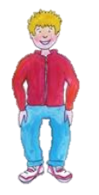
Engage
The EMMANUEL Project
Meet Sam –He loves rescues, he is a good swimmer and wants to join the life saving group at his local swimming club.
Activity: In ‘talk trios’ discuss a film where there is a rescuer – Sketch an image of the film and answer these questions in your book.
What is the name of your film?
The name of a film where there is a rescuer is…
Who needed rescuing?
Why did they need saving?
Was it someone’s fault?
Who was the rescuer?
What did the rescue cost?

Slide 6
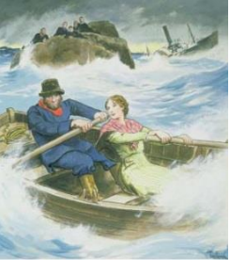
Engage
The EMMANUEL Project
Why do you think there are so many rescues in films? Are rescuers needed in the real world?
What do you think?
Have you ever been the ‘rescuer’?
A Real life rescuer!

Slide 7
Engage
The EMMANUEL Project

Slide 8
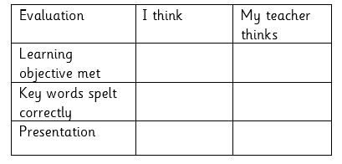
Engage
The EMMANUEL Project
Grace said she did not want to be famous; it was God who had helped her accomplish the rescue.
What do you think she meant?
Ask the children what consequences the events had for her life.
Was it worth it?

Slide 9
Enquire
Lesson 2
L.O: To understand what it means when Christians call Jesus their Saviour.
The EMMANUEL Project

Slide 10
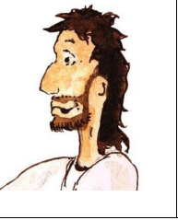
Enquire
The EMMANUEL Project

Slide 11
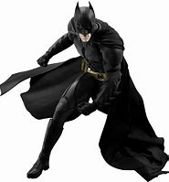
Enquire
The EMMANUEL Project
Sam loves rescues! He loves games where he is the hero and rescues people. He is an expert on cartoon superheroes. He likes to think Jesus is a superhero too because he rescues people and the vicar says he came to save the world.
But Jesus is not the same as Batman and all the others, not really.
Superheroes save people!
Activity – Write down the characteristics of a superhero.
Post it notes around image.
Compare Jesus – is Jesus a superhero. He can rescue people.
Read the story of Zacchaeus.

Slide 12
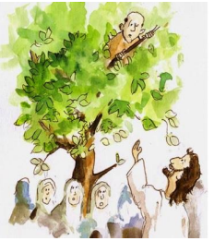
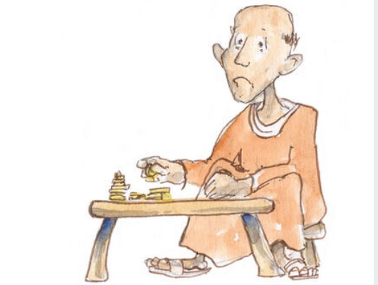
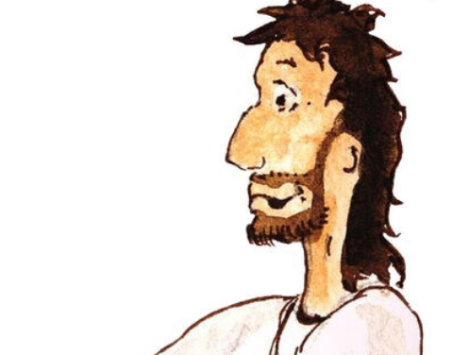
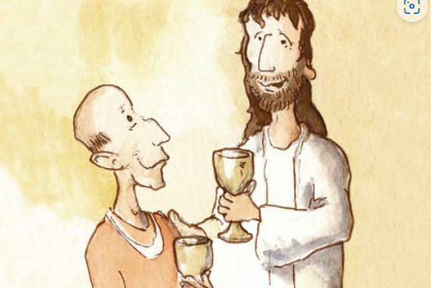
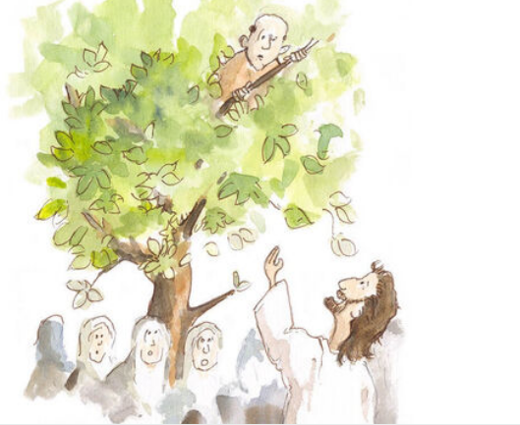
Enquire
There is a story where he actually said he had come to save people - the story of Zacchaeus
Read Luke 19 v1-9

Slide 13
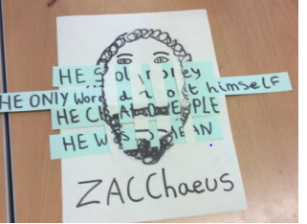
Enquire
Why did the crowds see Zacchaeus as a sinner? Do you think Zacchaeus had friends? How did Jesus ‘save’ him
Activity – Draw the simple outline of Zacchaeus and then use simple basket weaver to weave some of the sinful things that he did.
Talk about the kind of things which spoil people’s lives e.g. lying, cheating, being selfish.
What’s happened to the picture? Spoilt! The original is there, but not perfect now.
What did Jesus say about the change in Zacchaeus? Jesus said: Salvation has come to your house i.e. you have been rescued. He had already realised he was in the wrong and started to put things right. I wonder how else his life went on to change.

Slide 14
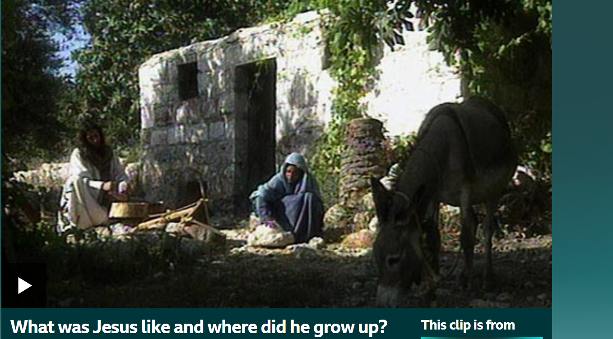
Explore
Lesson 3
L.O: To explore the Christian belief that Jesus brings ‘Salvation’ (through Bible Narrative)
‘What was Jesus like and where did he grow up?
BBC Two - Pathways of Belief, Christianity: Jesus, What was Jesus like and where did he grow up?

Slide 15
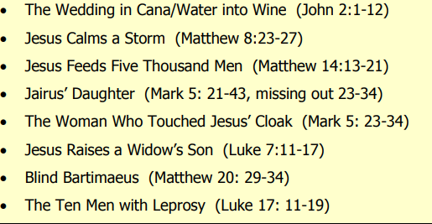
Explore
Jesus quickly became so popular that people followed him everywhere. He was beginning to live up to his name as ‘saviour’.
Activity – in small groups choose a story and read the passage.
Create a freeze frame showing the rescues.
Perform your freeze frame to the class – children to guess which story it is.
Evidence- photo of freeze frame.
Book work – Write a paragraph – why do you think this story inspires Christians.

Slide 16
Explore
Lesson 4
L.O: To explore the Christian belief that Jesus brings ‘Salvation’ (through Church Practice)
Q – What place does Jesus the Saviour have in church services at Christmas?

Slide 17
Explore
Sam says: At Christmas we put out a giant crib set at our church and people come to sing carols around the crib and tell the Christmas story. What do you know about Christmas?
Sam says: Christmas is when we celebrate the birth of Jesus. We believe he is the ‘Saviour of the World’, the most special baby ever. I have to choose carols for our Crib service. Can you help me find carols about Jesus the saviour, please?
Once In Royal David's City Once in royal David's city Stood a lowly cattle-shed Where a mother laid her Baby In a manger for His bed; Mary was that mother mild, Jesus Christ her little child. He came down to earth from heaven, Who is God and Lord of all, And His shelter was a stable, And His cradle was a stall; With the poor, and mean, and lowly, Lived on earth our Saviour holy.
Activity – take a carol and underline words relating to ‘Saviour’ including saves, save, saving and saved.
Evidence- stick the copy of the hymn in your book.
Create a Christmas card using the line from the hymn.
This will be given to HILS Herts independent living service.
Lived on earth our Saviour holy.

Slide 18
Explore
Sam says: Thank you for helping me. You saved the day! At our church services over Christmas we remember Jesus is our saviour, helper, and friend. To show our thanks, we collect money for night shelters to save people from being out on the streets. We also save people from being lonely by offering Christmas lunch at the church hall; my mum and dad help cook and I set tables. We invite the Salvation Army band to come and play carols for us to sing in the afternoon. My friend, Emily, is in the band.

Slide 19
Explore
Lesson 5
L.O: To explore the Christian belief that Jesus brings ‘Salvation’ (through Christian Living)
Q – If you are rescued, is it your responsibility to rescue or help others?

Slide 20
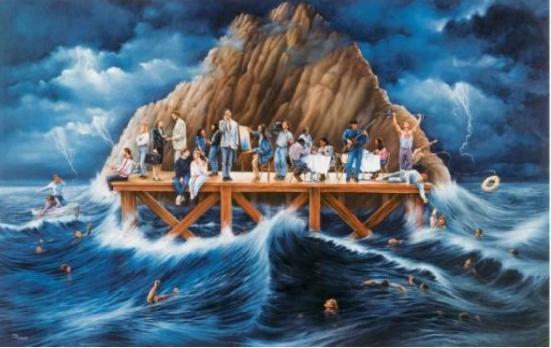
Explore
‘Who Cares?’ by Mauricio Palacio.

Slide 21
Explore
It depicts William Booth’s vision of the lost; it represents people ignoring those wanting to be saved, to get on with their own lives.
Are the rescued now rescuing?
Where is this in the picture?
What can you see?
What is the artist trying to show?
Activity – write what you can see around the image. Answer these questions.

Slide 22
Explore
How and why does the Salvation Army, a Christian church, serve?
Booth was inspired by Jesus to love and serve everyone, not just people you like; he thought all Christians should serve others. Booth’s passion inspired others and the Salvation Army is known both for talking about Jesus the Saviour but also for working to ‘save’ people in real need.
Saved to serve’ is the Salvation Army motto, symbolised by the ‘S’ on their uniform. The salvation army are famous the world over for taking seriously the need to serve other people as their response to Jesus saving and helping them.

Slide 23
Explore
Activity – Stick this in your book and research ways The Salvation Army help others.
Salvation Army website ( https://www.salvationarmy.org.uk/ )
Activity – what ways can you help?

Slide 24
Evaluate
L.O: To explore the Christian belief that Jesus bring ‘Salvation’ (through Christian Living)
The EMMANUEL Project

Slide 25
Evaluate
How does believing Jesus is their saviour inspire Christians to save and serve others?
Self assessment – Where are you now?

