Slide 1
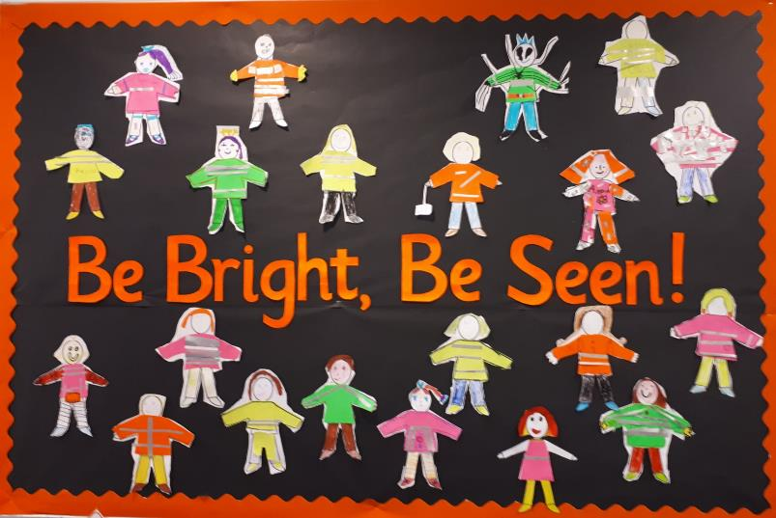

Slide 2
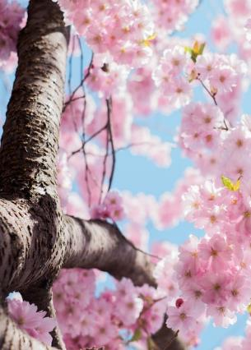
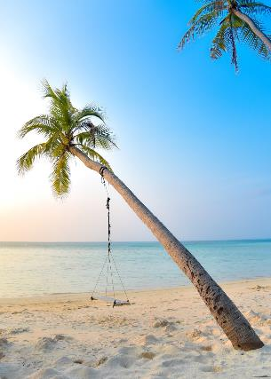
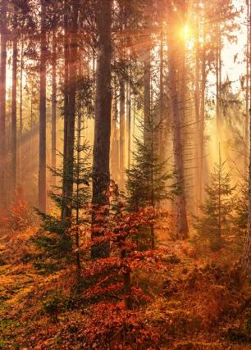
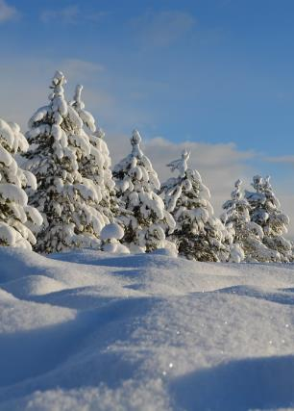
Seasons of the year
Notes:
Ask pupils to name the four seasons of the year
Talk about the different types of weather in each season
Eg Summer – hot, sunny, dry
Autumn – leaves fall off trees, not as warm as summer
Winter – cold, snowy, icy, dark
Spring – starts to warm up, can be rainy

Slide 3
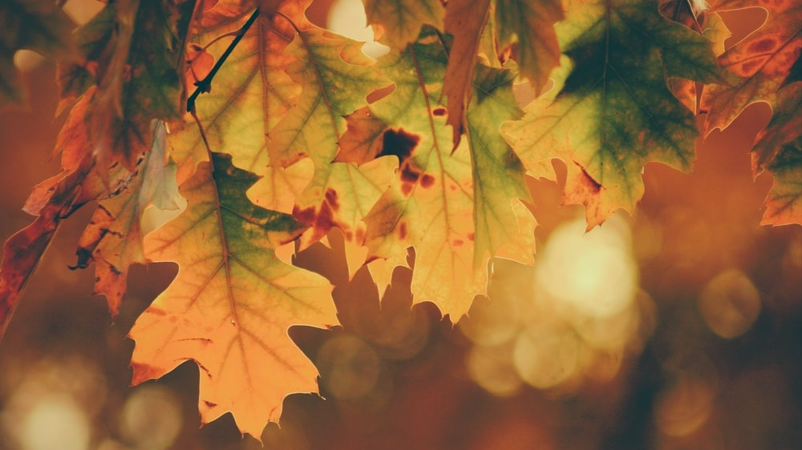
What happens in Autumn?
Notes:
Ask pupils if they know of anything specific that happens in Autumn (besides leaf fall)….
….The clocks change
Ask pupils what happens after the clocks have changed…
….it gets darker in the afternoons, it might be dark when you leave school/after school clubs

Slide 4
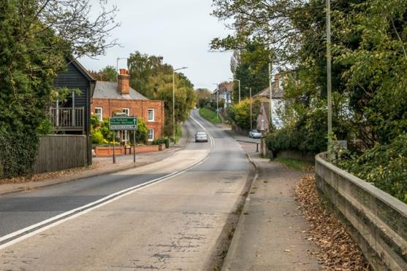
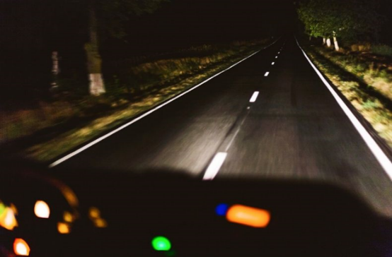
Summer Autumn/Winter
Notes:
Ask pupils to imagine they were drivers in the above cars, and that they were driving in the evening
In the first photo, in the summer, visibility is good. The driver can see the road, the buildings, the footpath at the side of the road
In the second photo, the driver can see very little other than the road immediately in front of them (thanks to the headlights)

Slide 5
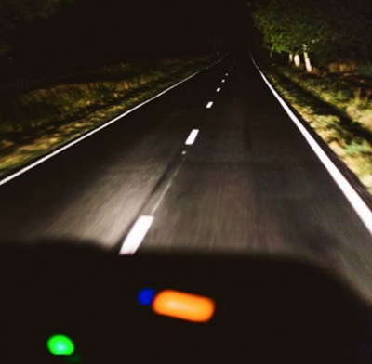
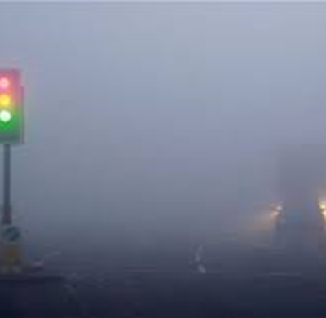
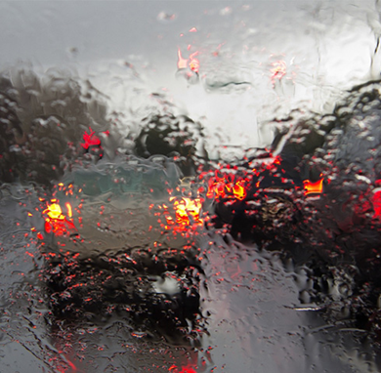
Darkness Foggy Rainy
Notes:
Ask pupils to describe what the weather is usually like in autumn/winter

Slide 6
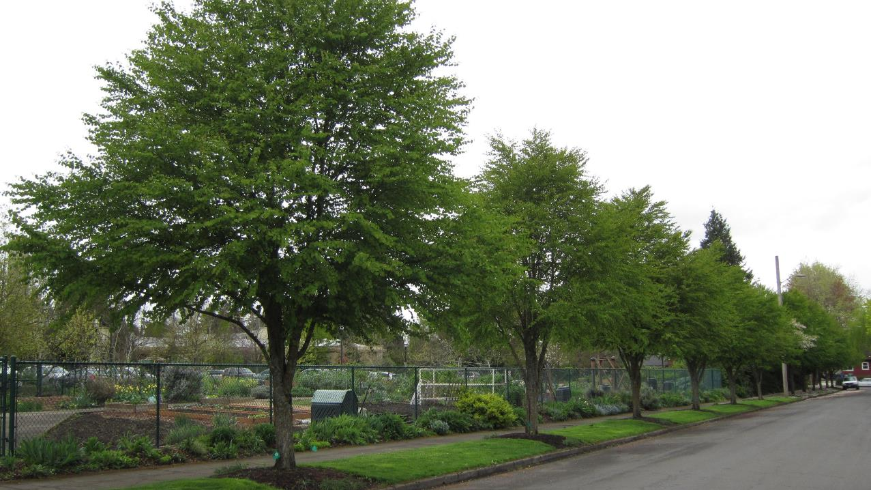
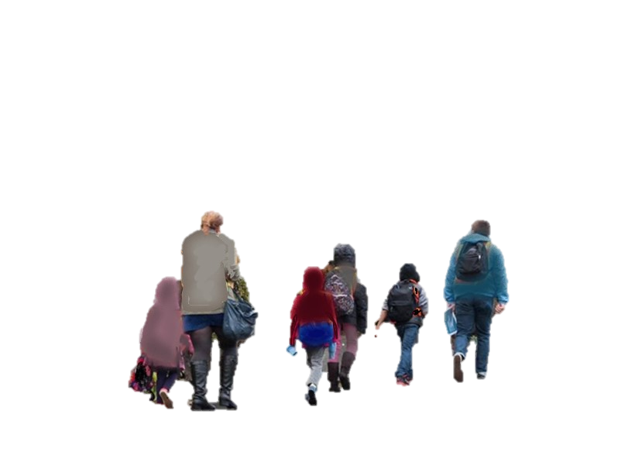
Notes:
Ask pupils to look at the picture of the adults and children walking on the side of the road. They are wearing dull colours which blend into the background

Slide 7
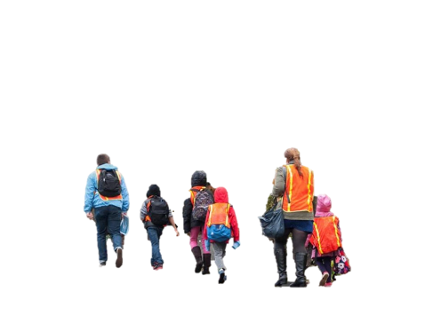
Notes:
Now cars can see the adults and children because they are wearing bright clothing

Slide 8
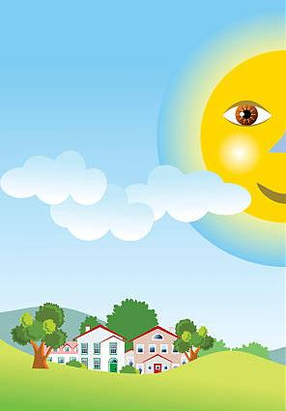
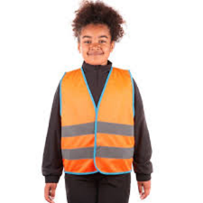
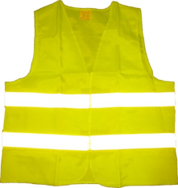
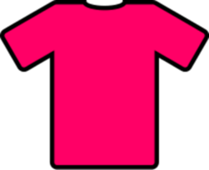
Be bright in the daytime
Notes:
Explain that fluorescent materials show up during the day

Slide 9
What about in the night time?

Slide 10
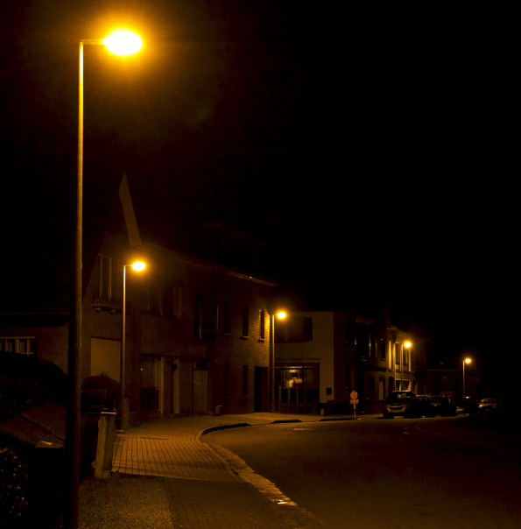
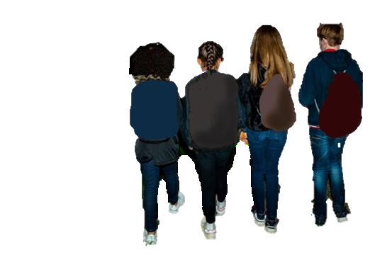
Notes:
Explain that the pupils cannot be seen very clearly in the night time because of their dull clothing

Slide 11
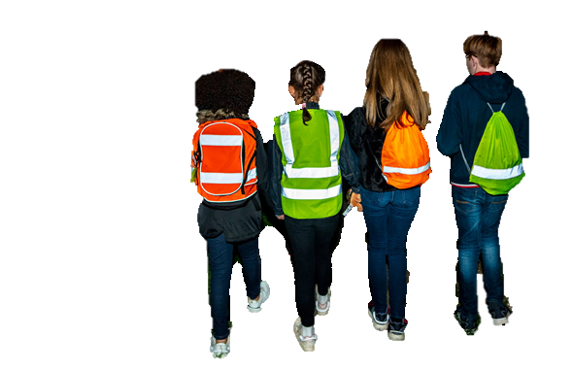
Notes:
Now the pupils can be seen by drivers because they are wearing bright and reflective clothing

Slide 12
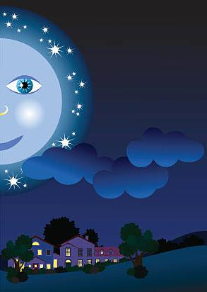
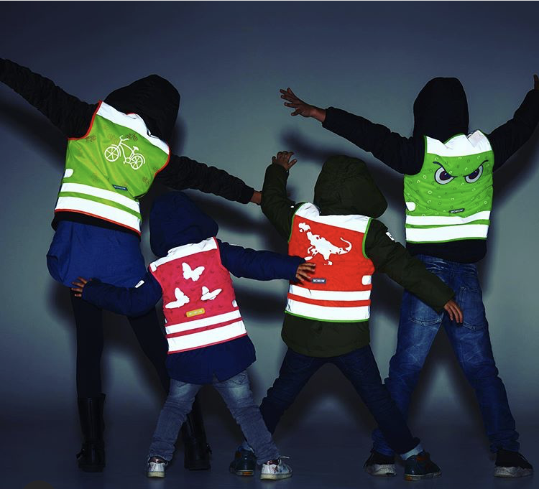
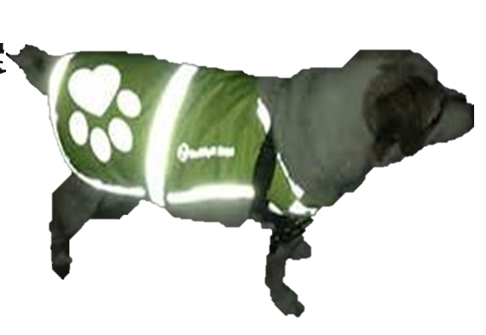
Be shiny in the night time
Notes:
Explain that reflective materials show up at night.

Slide 13
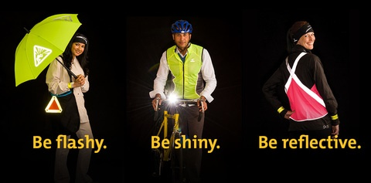

Slide 14
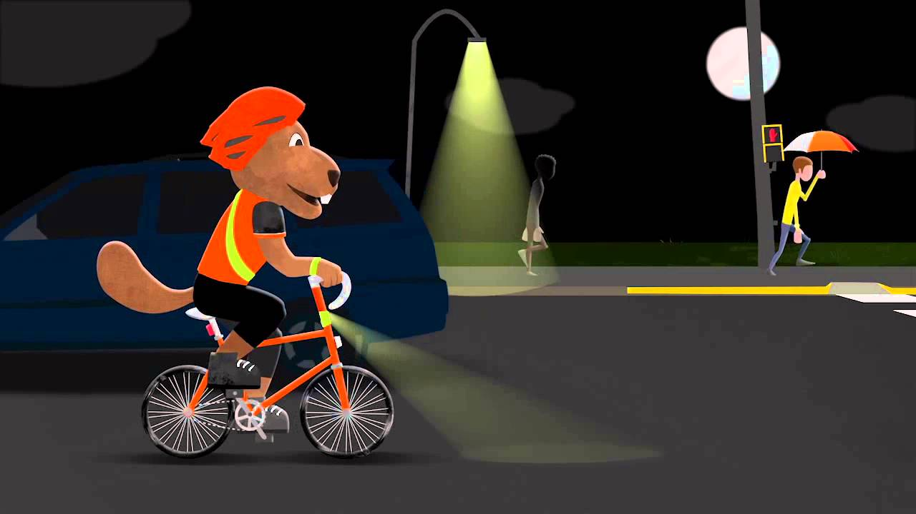
What about when I am riding a bike in the night time?

Slide 15
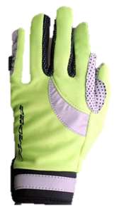
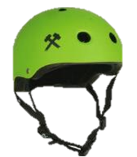
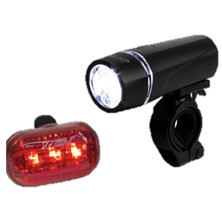
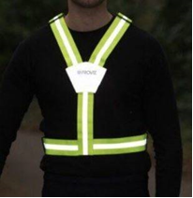
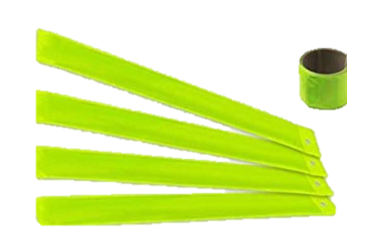
Things you could wear!
Helmets
Lights
Gloves
Reflective belt
Reflective strips
Notes:
If you ride a bike you need to have clean working lights for both the front and the back of the bike.
You can add reflective accessories to yourself and your bike.
REMINDER: CLICK TWICE FOR BIKE WHEELS TO SPIN

Slide 16
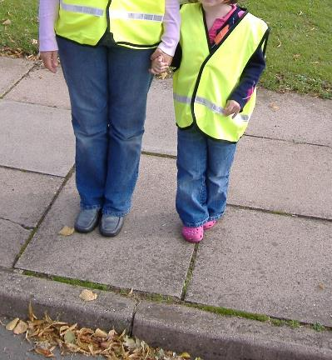
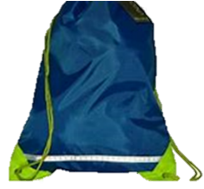
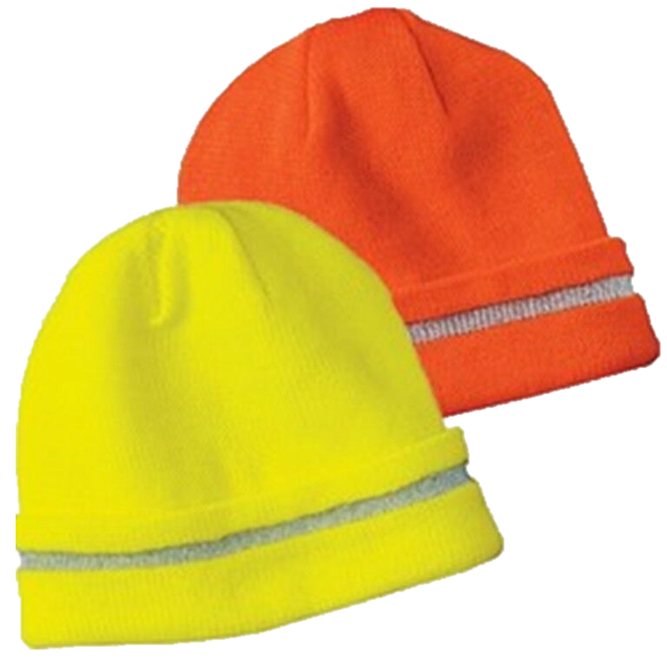
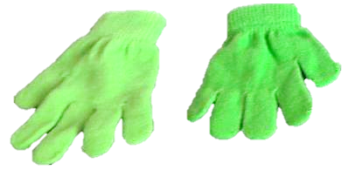
What else can I wear?
Notes:
Explain that children don’t have to dress head to toe in fluorescent and reflective clothing
There are lots of different ways of adding something reflective to your usual outfit – eg a reflective wrist/arm band, a reflective strip on your bag or coat, a bright or reflective hate, a key ring attached to your coat zip
Explain that lots of children's’ clothing has some form of reflective strip on it somewhere, ask pupils to have a look at their coats. It might be around the cuffs, on the zip or pockets, or on the back or the hood
Next time pupils are choosing new clothing with an adult, ask them to look out for something bright/fluorescent/reflective

Slide 17
Be Bright Be Seen

